Slide 1
Chapter topics:
Detailed study of the covalent bond theories: (a) The nature of the covalent bonding: wave mechanical principle, valence bond theory (VBT) of hydrogen molecule, hybridization, VBT description using hybrid orbitals, resonance. (b) Molecular orbital theory (MOT) of homo-and hetero-diatomic molecules, HOMO and LUMO, molecular orbitals of polyatomic molecules with σ and π-bonding, the ligand group orbital approach, comparison of VBT and MOT.

Slide 2
TYPES OF BONDS
Atoms may attain a stable electronic configuration in three different ways:
by losing electrons, by gaining electrons, or by sharing electrons.
Elements may be divided into:
I. Electropositive elements, whose atoms give up one or more electrons
fairly readily.
2. electronegative elements. which will accept electrons.
3. Elements which have little tendency to Jose or gain electrons.
Three different types of bond may be formed, depending on the
electropositive or electronegative character of the atoms involved.

Slide 3
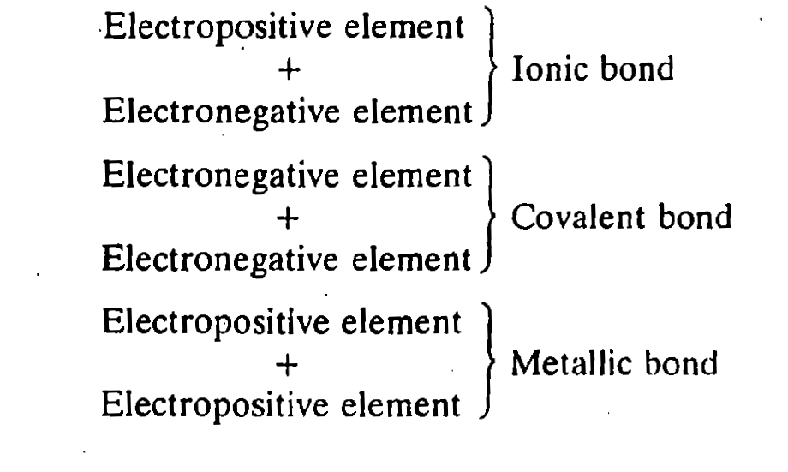

Slide 4
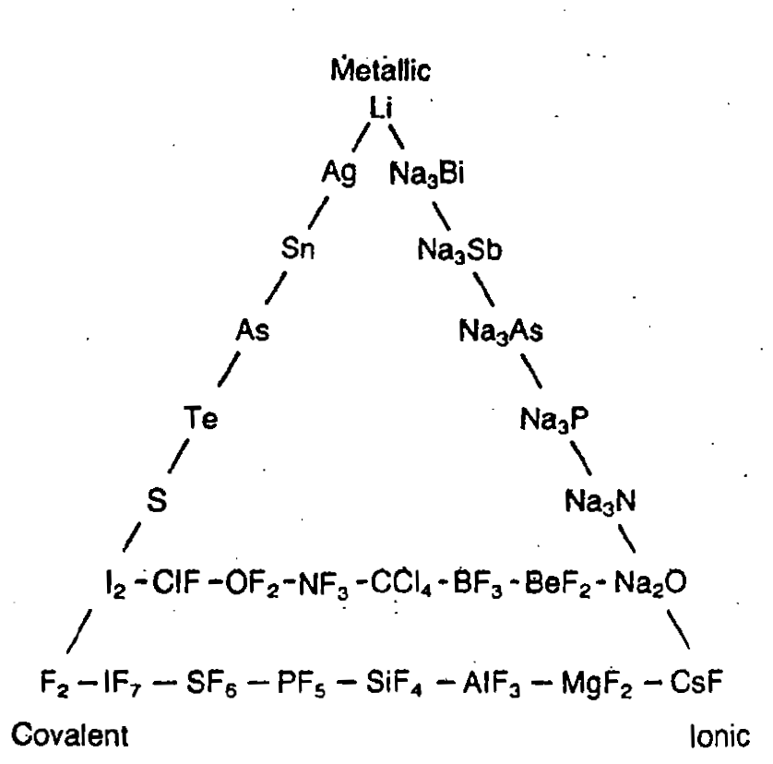
If the three extreme bond types are placed at the corners of a triangle, then compounds with bonds predominantly of one type will be represented as points near the corners. Compounds with bonds intermediate between two types will occur along an edge of the triangle, whilst compounds with bonds showing some characteristics of all three types are shown as points inside the triangle.

Slide 5
This theory was proposed by Linus Pauling, who was awarded the Nobel Prize for Chemistry in 1954. The theory was very widely used in the period 1940-1960. Since then it. has to some extent fallen out of fashion. However, it is still much used by organic chemists, and it provides a basis for simple description of small inorganic molecules.
Atoms with unpaired electrons tend to combine with other atoms which also have unpaired electrons. In this way the unpaired electrons are paired up, and the atoms involved all attain a stable electronic arrangement. This is usually a full shell of electrons (i.e. a noble gas configuration). Two electrons shared between two atoms constitute a bond. The number of bond is formed by an atom is usually the same as the number of unpaired electrons in the ground state, i.e. the lowest energy state. However, in some cases the atom may form more bonds than this. This occurs by excitation of the atom (i.e. providing it with energy) when electrons which were paired in the ground state are unpaired and promoted into suitable empty orbitals. This increases the number of unpaired electrons, and hence the number of bonds which can be formed.

Slide 6
The shape of the molecule is determined primarily by the directions in which the orbitals point. Electrons in the valence shell of the original atom which are paired are called lone pairs.
Examples
1. In HF, H has a singly occupied s orbital that overlaps with a singly filled 2p orbital on F.
2. In H₂O, the O atom has two singly filled 2p orbitals, each of which overlaps with a singly occupied s orbital from two H atoms.
3. In NH₃ , there are three singly occupied p orbitals on N which overlap with s orbitals from three H atoms
Discrepancy in CH₄ led to the concept of Hybridization

Slide 7
In 1916, G. N. Lewis proposed that a chemical bond forms by the interaction of two shared bonding electrons, with the representation of molecules as Lewis structures. In 1927 the Heitler–London theory was formulated which for the first time enabled the calculation of bonding properties of the hydrogen molecule H₂ based on quantum mechanical considerations.
Specifically, Walter Heitler determined how to use Schrödinger's wave equation (1926) to show how two hydrogen atom wave functions join together, with plus, minus, and exchange terms, to form a covalent bond. He then called up his associate Fritz London and they worked out the details of the theory over the course of the night.^{[2]}
Later, Linus Pauling used the pair bonding ideas of Lewis together with Heitler–London theory to develop two other key concepts in VB theory: resonance (1928) and orbital hybridization (1930). According to Charles Coulson, author of the noted 1952 book Valence, this period marks the start of "modern valence bond theory", as contrasted with older valence bond theories, which are essentially electronic theories of valence couched in pre-wave-mechanical terms.

Slide 8
(VB) theory is one of two basic theories, along with molecular orbital (MO) theory, that were developed to use the methods of quantum mechanics to explain chemical bonding. It focuses on how the atomic orbitals of the dissociated atoms combine to give individual chemical bonds when a molecule is formed. In contrast, molecular orbital theory, which will be discussed elsewhere, predict wave functions that cover the entire molecule.
The simplest case to consider is the hydrogen molecule, H2. When we say that the two hydrogen
nuclei share their electrons to form a covalent bond, what we mean in VB theory terms
is that the two spherical 1s orbitals (the grey spheres in Figure 12.2.1) overlap and contain two electrons.
Source: https://chem.libretexts.org/Bookshelves/Physical_and_Theoretical_Chemistry_Textbook_Maps/
Map%3A_Physical_Chemistry_for_the_Biosciences_(Chang)/12%3A_The_Chemical_Bond/
12.2%3A_Valence_Bond_Theory
2. Inorganic Chemistry, James E. Huheey

Slide 9
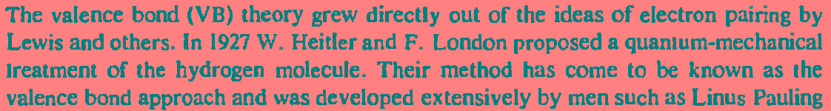

Slide 10
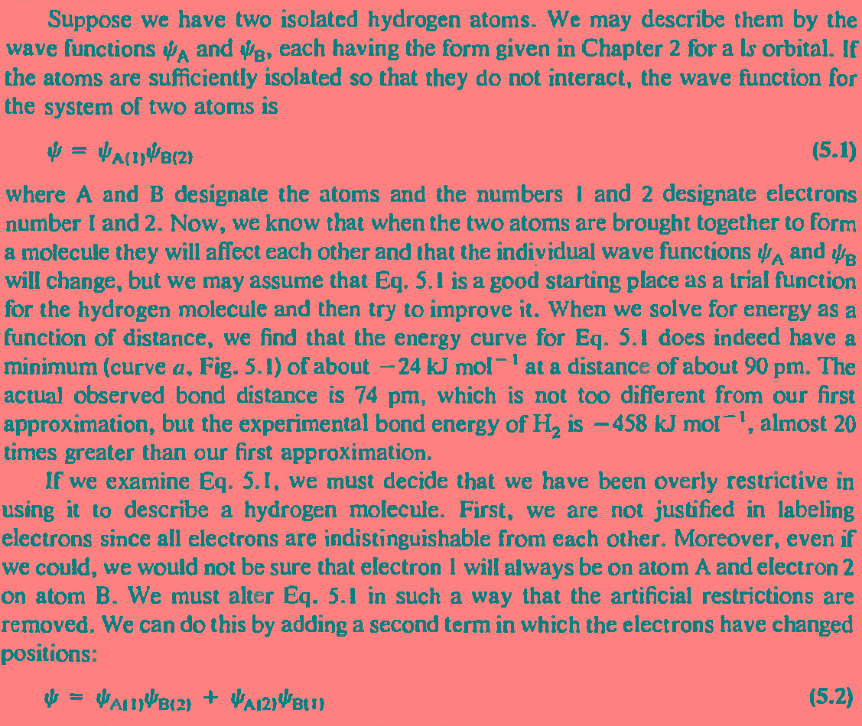

Slide 11
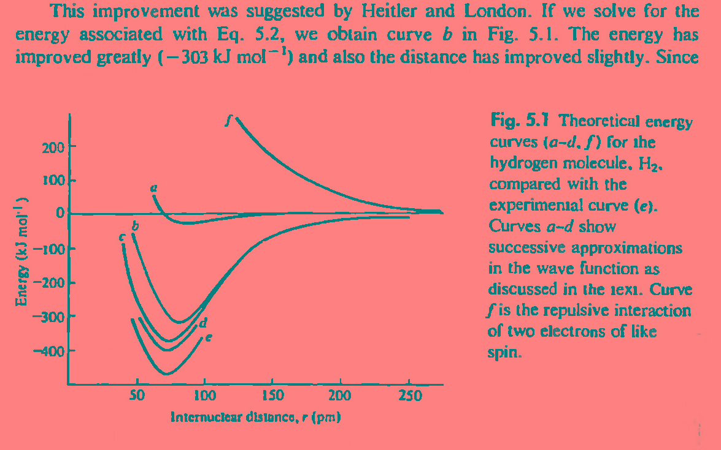
Repulsive interaction
simple
indistinguishability
Electron
shielding
Covalent –ionic character
experimental

Slide 12
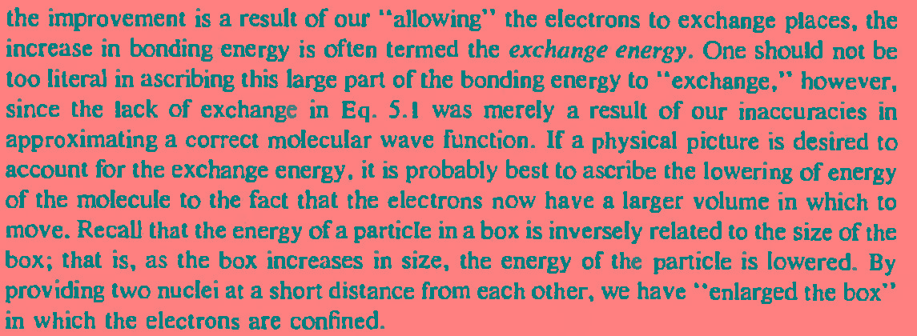

Slide 13
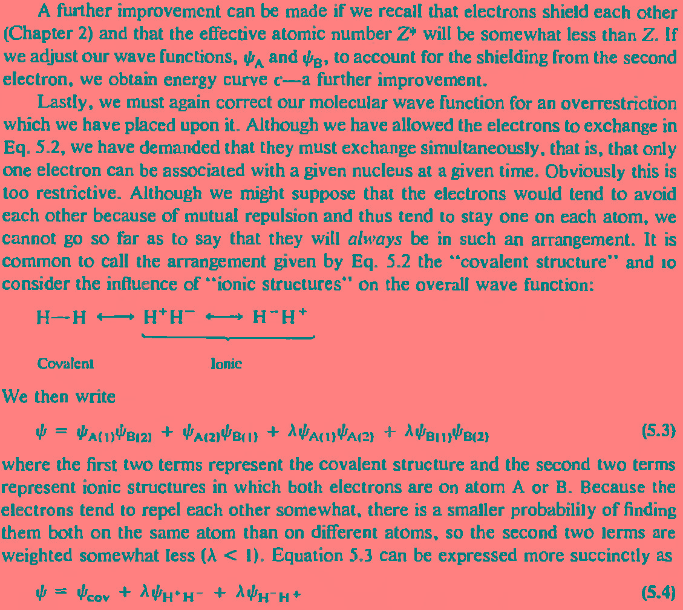

Slide 14
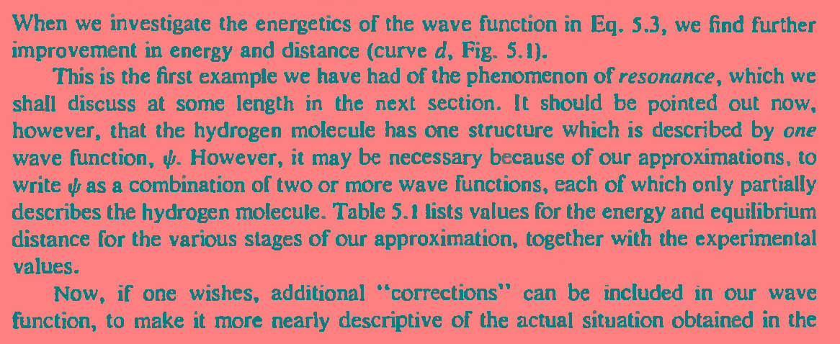

Slide 15
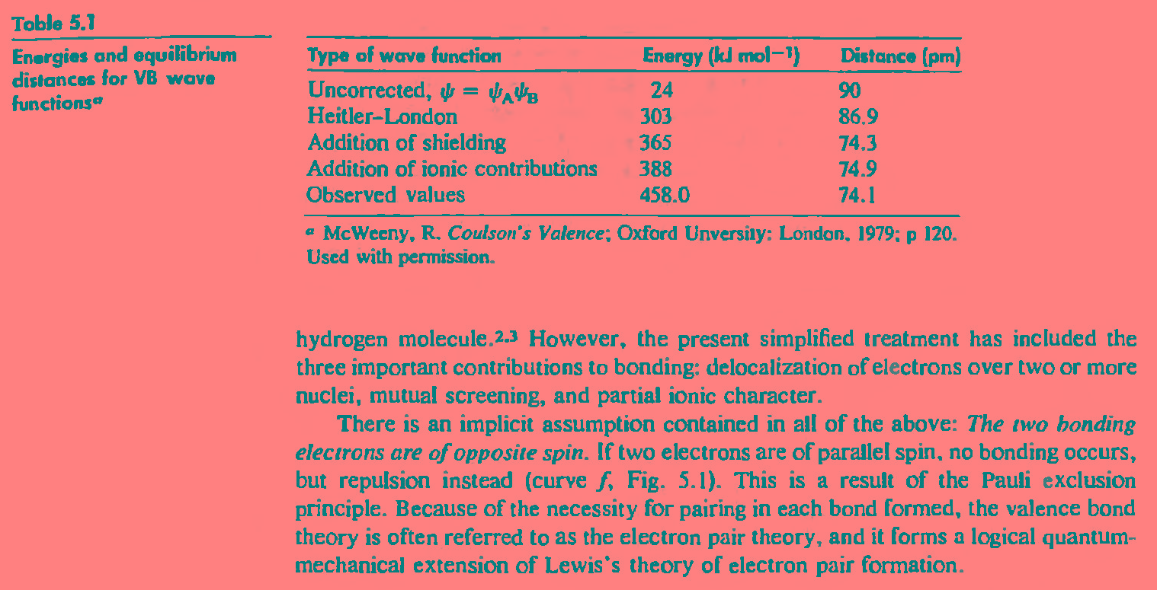

Slide 16
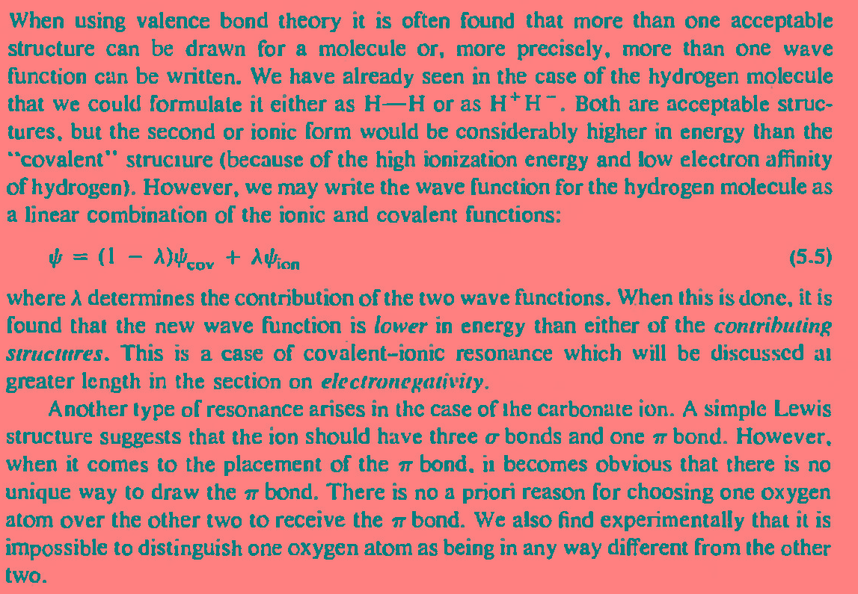

Slide 17
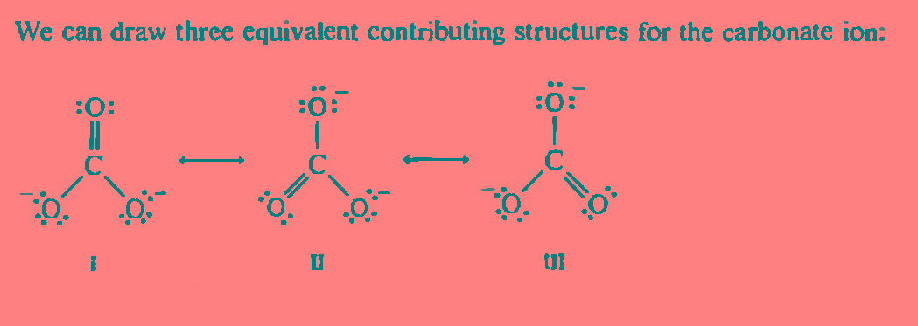
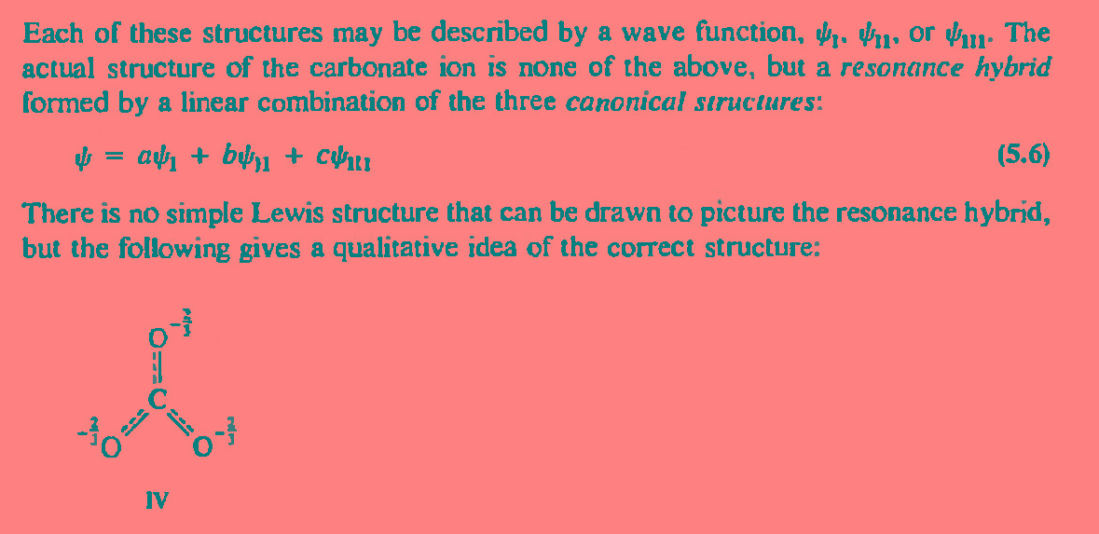

Slide 18
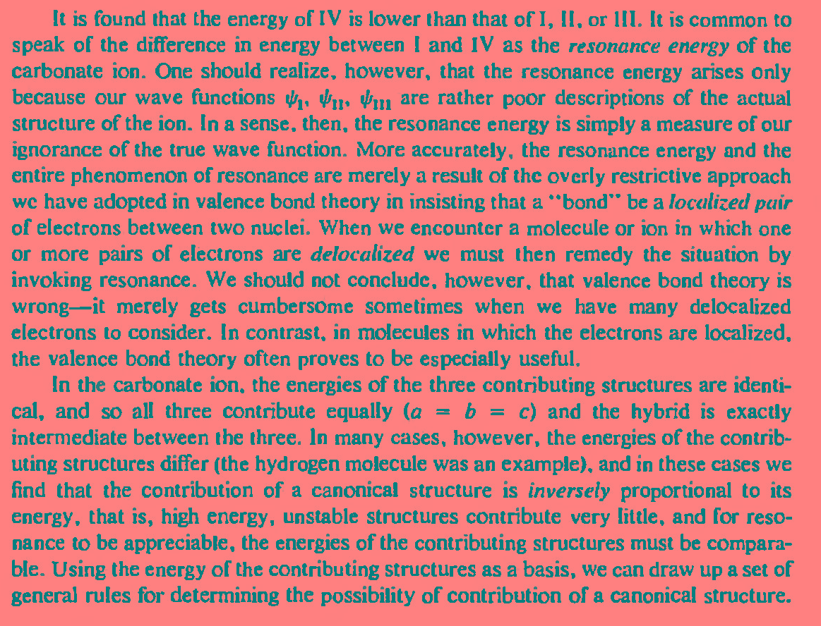

Slide 19
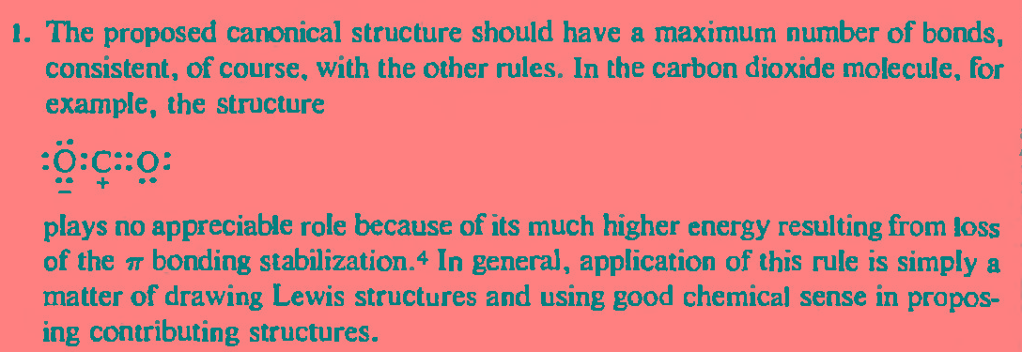
Rule no 1

Slide 20
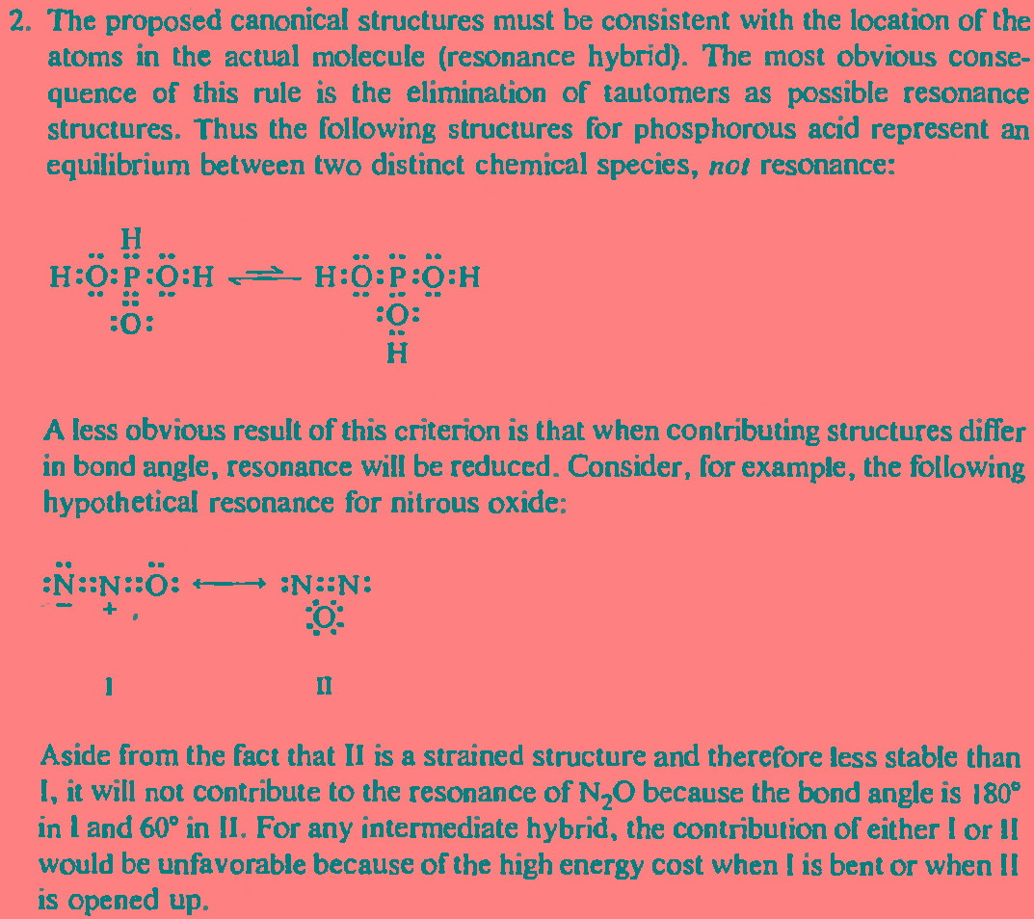
Rule no 2

Slide 21
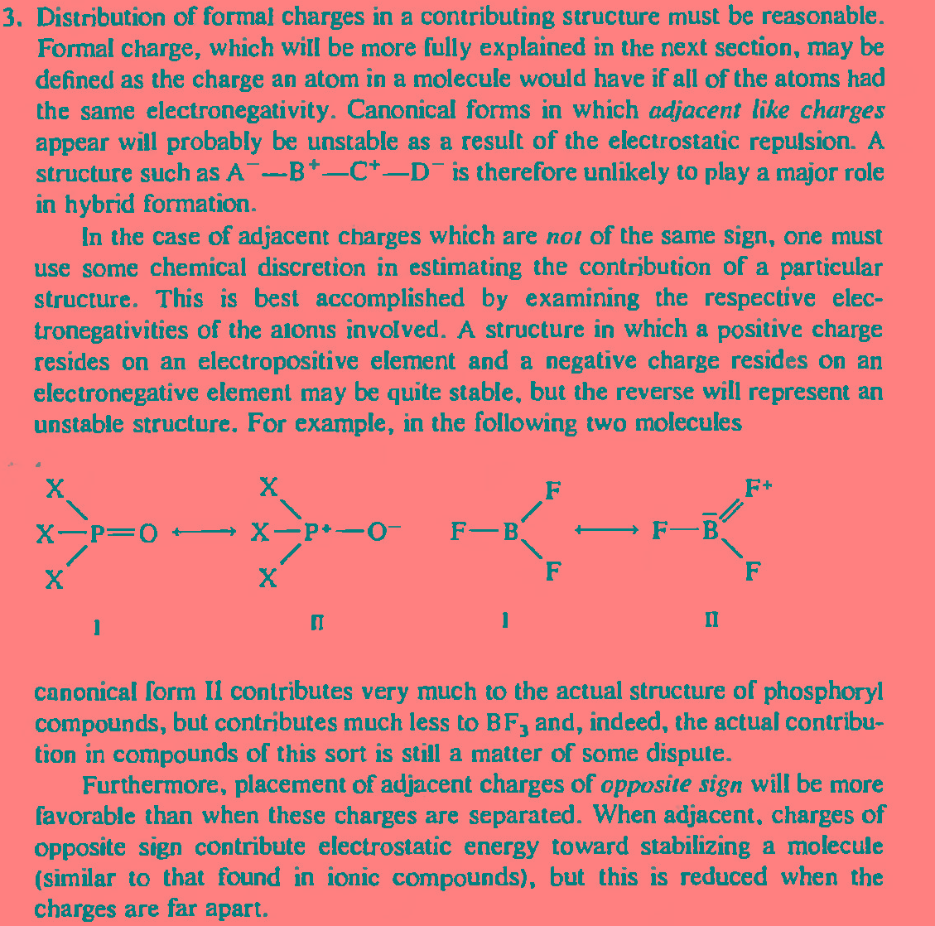

Slide 22
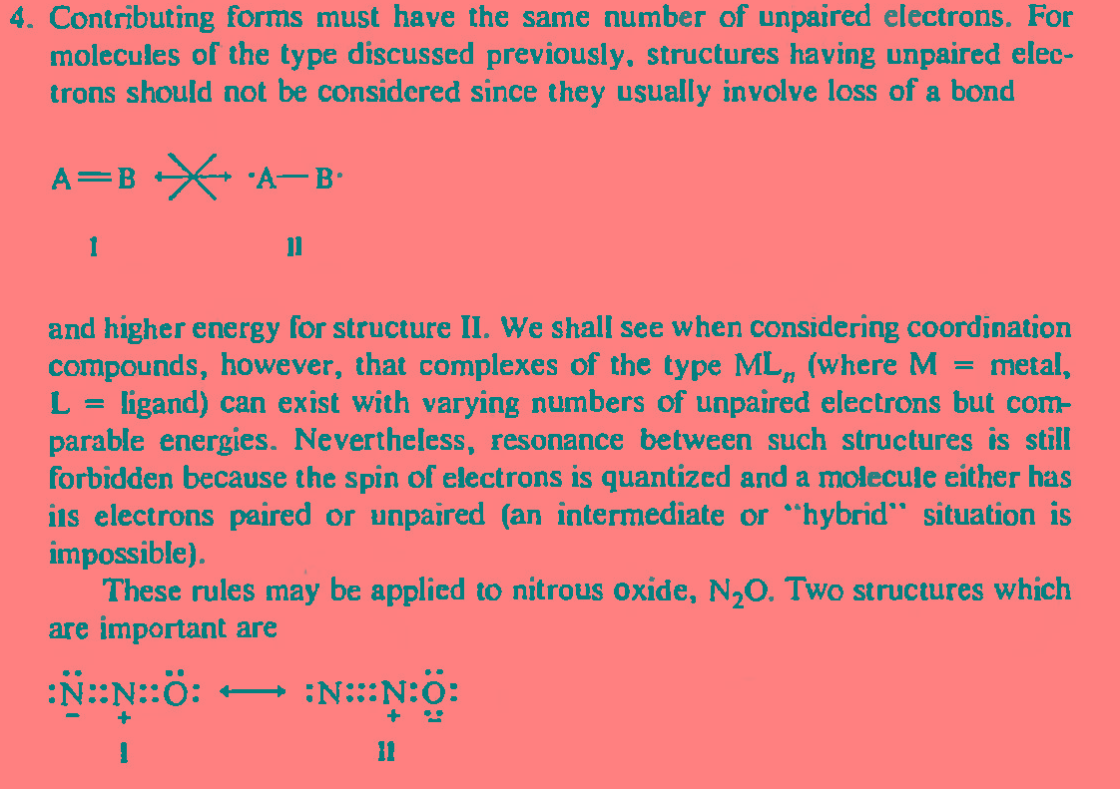

Slide 23
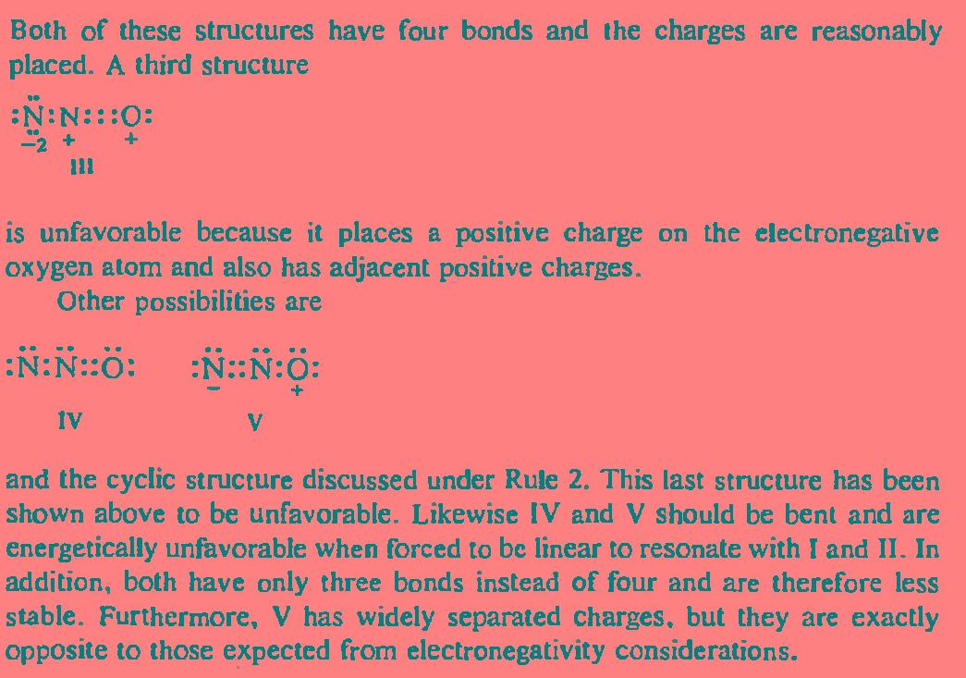

Slide 24
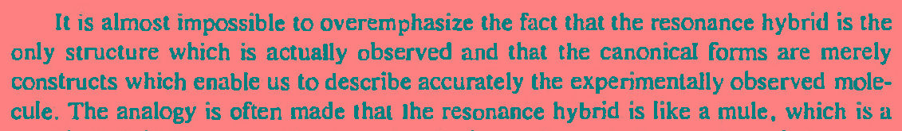

Slide 25
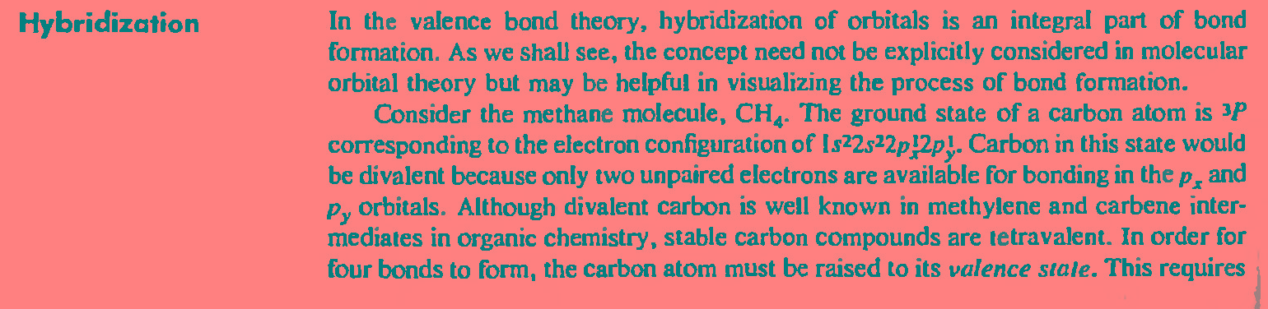

Slide 26
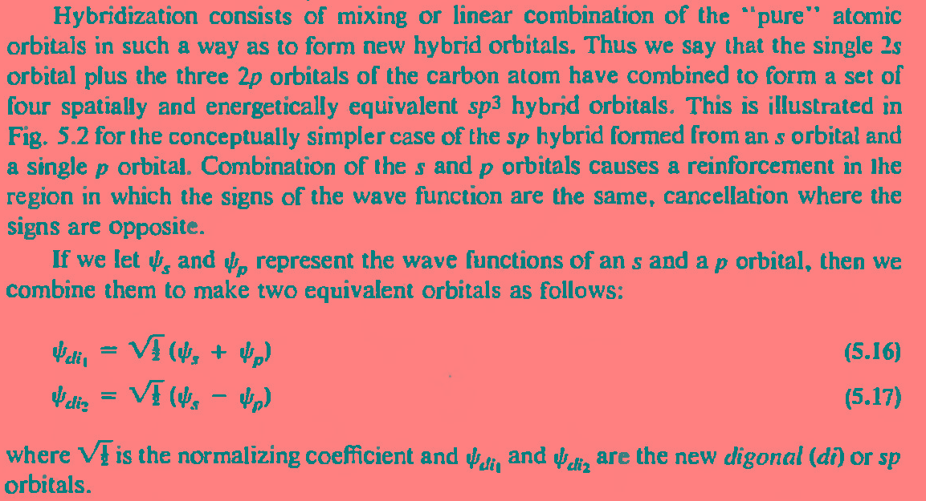

Slide 27
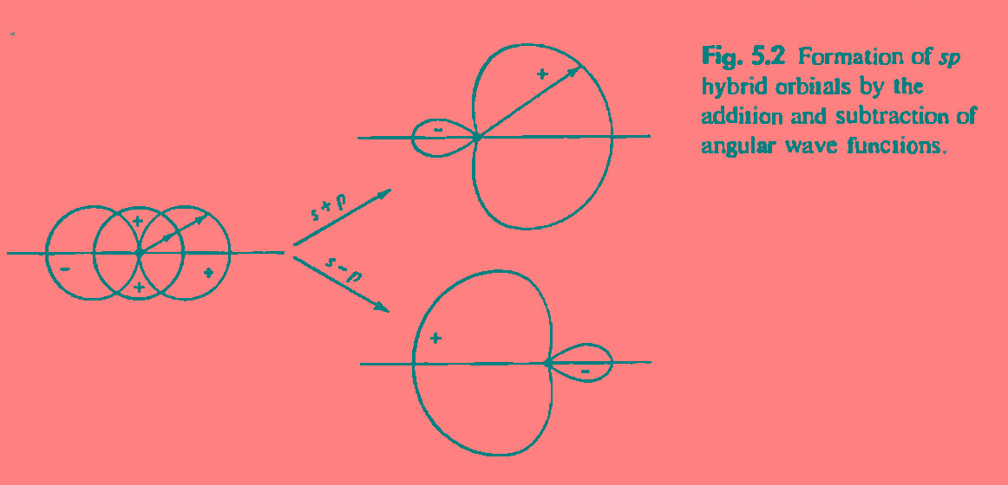

Slide 28
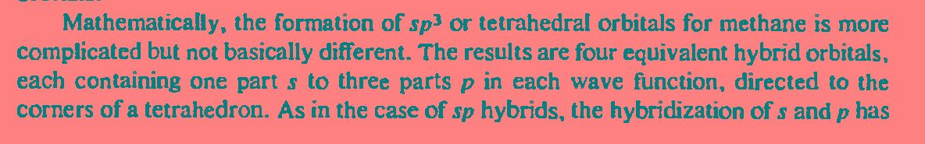
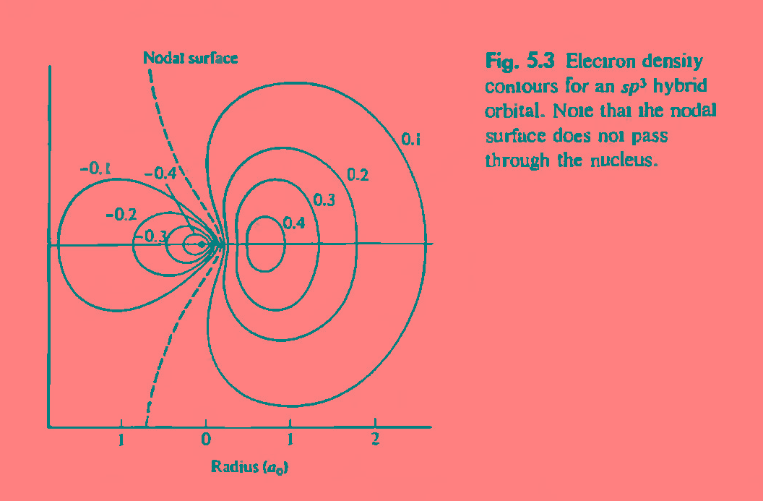

Slide 29
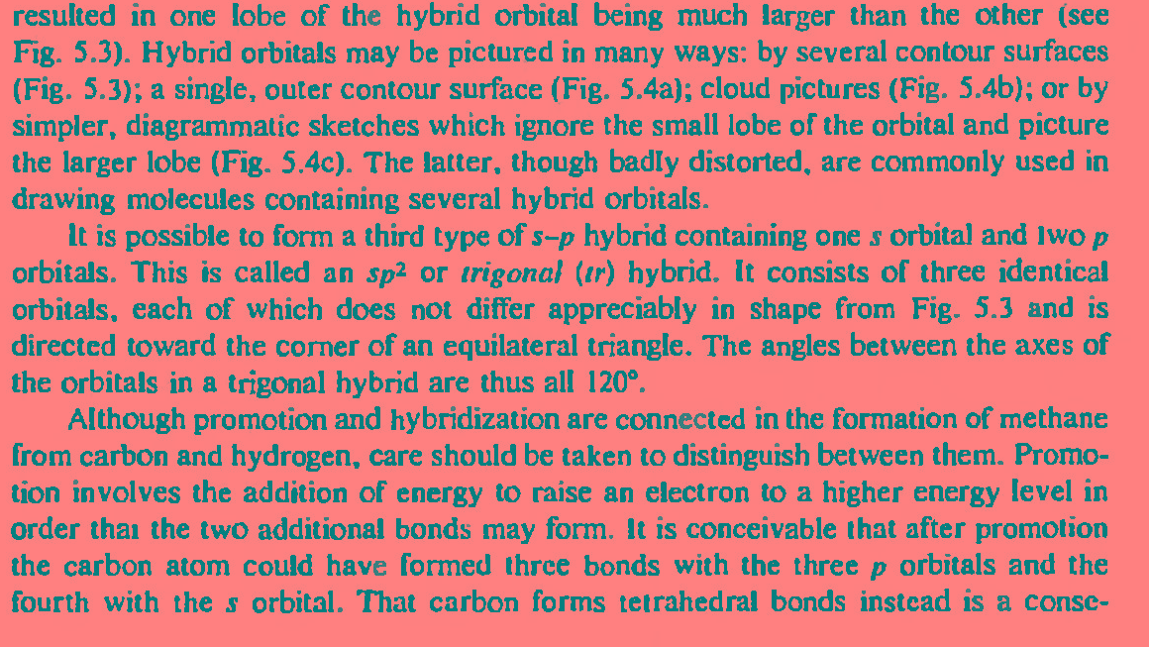

Slide 30
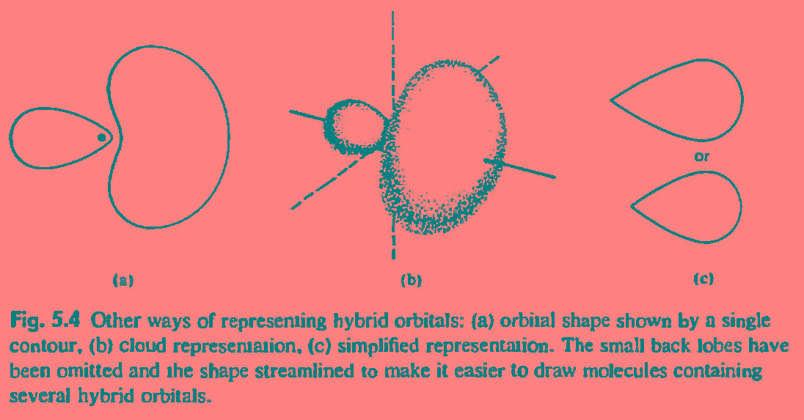

Slide 31
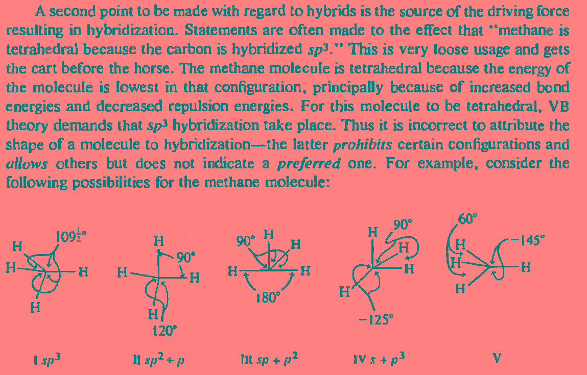

Slide 32
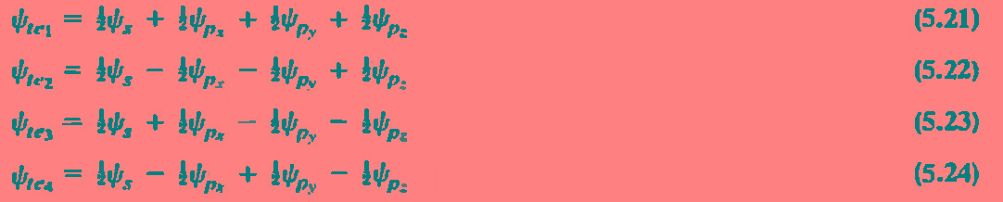
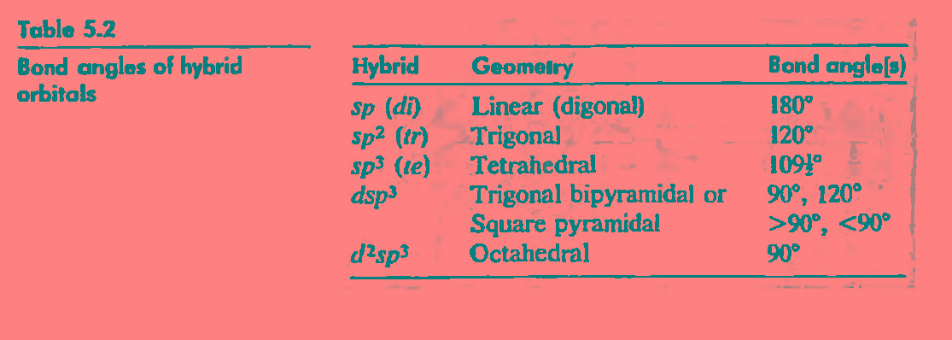

Slide 33
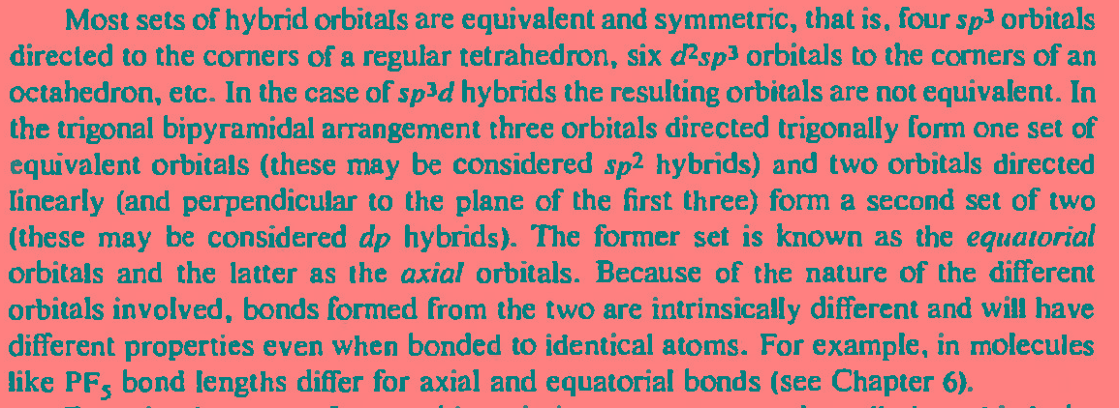

Slide 34
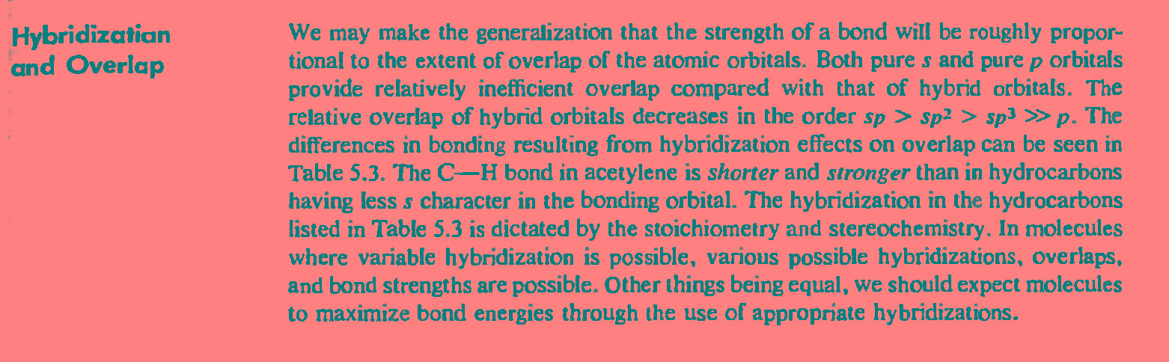

Slide 35
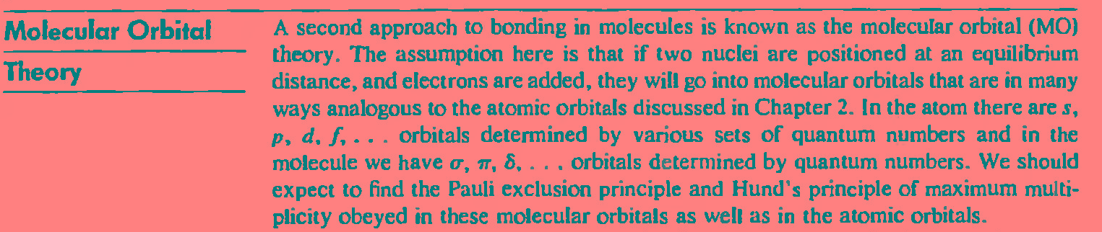
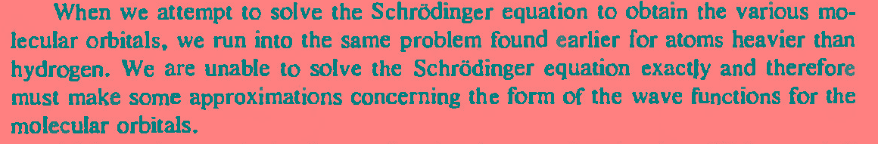
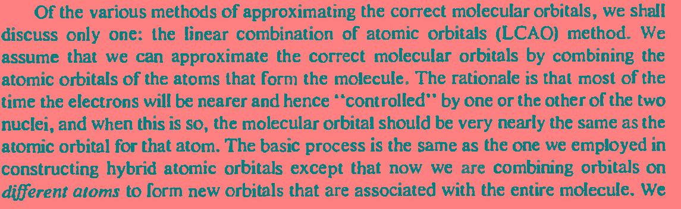

Slide 36
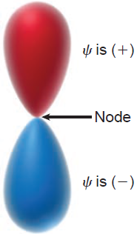

Slide 37
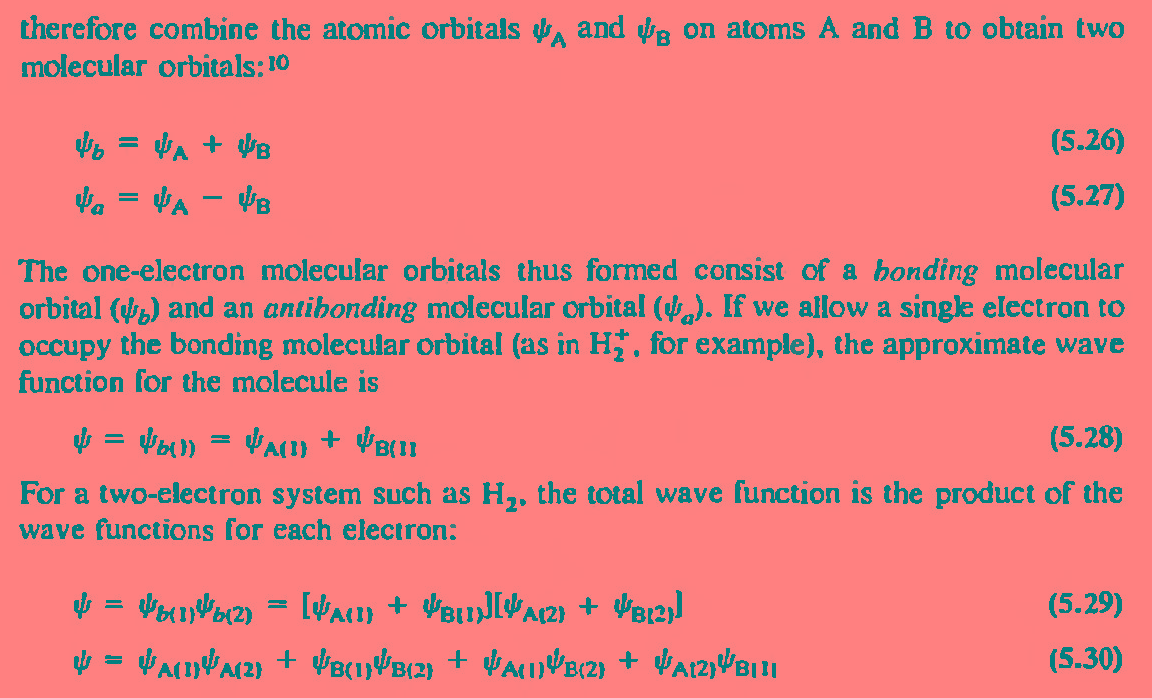

Slide 39
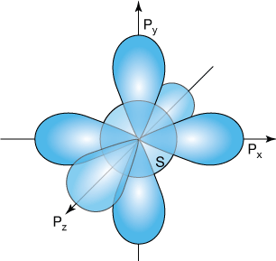

Slide 40
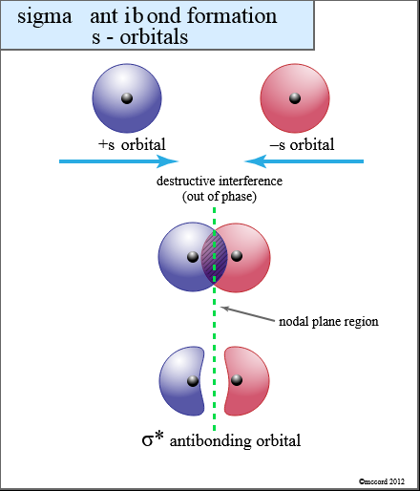

Slide 41
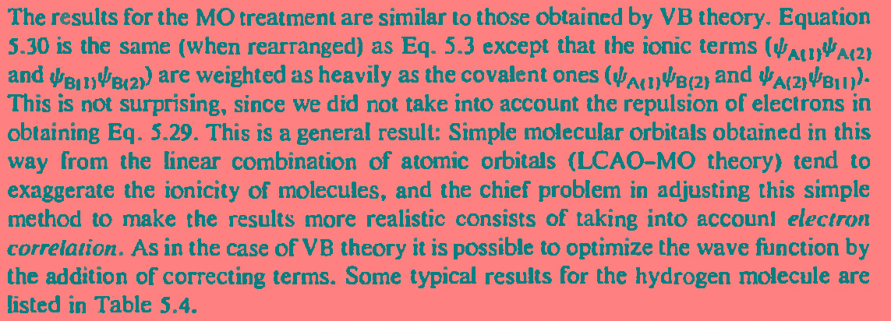
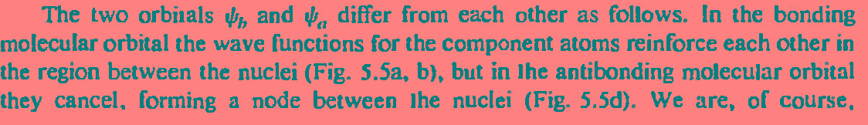

Slide 42
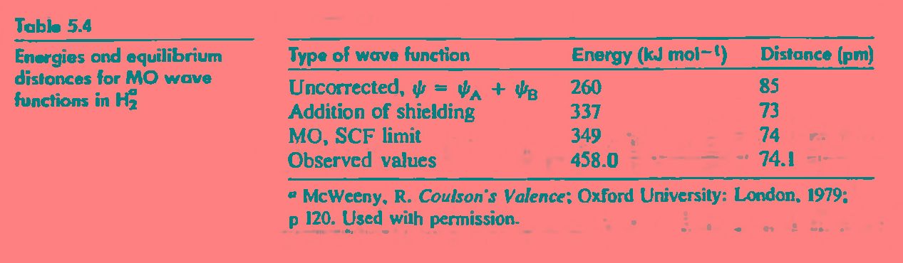

Slide 43
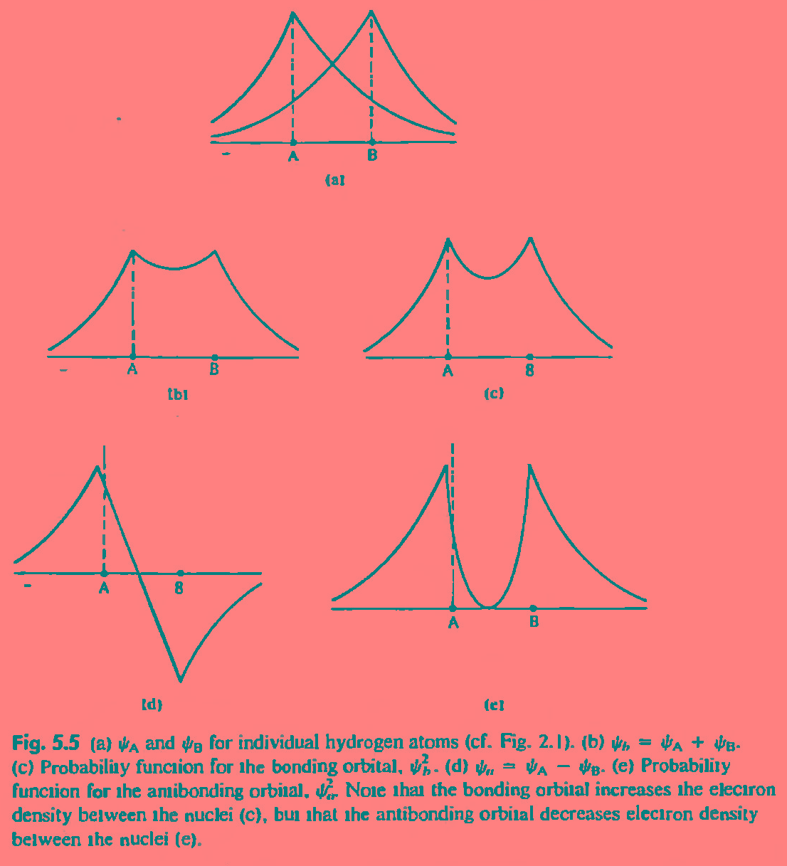

Slide 44
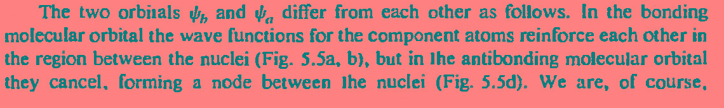
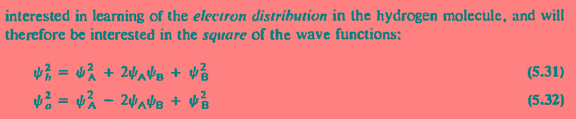

Slide 45
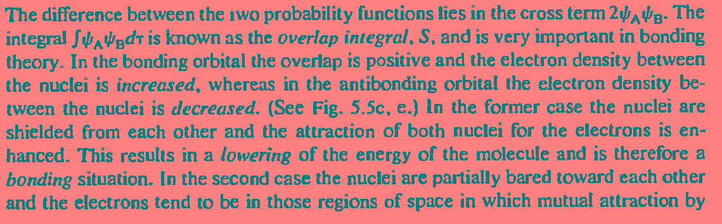
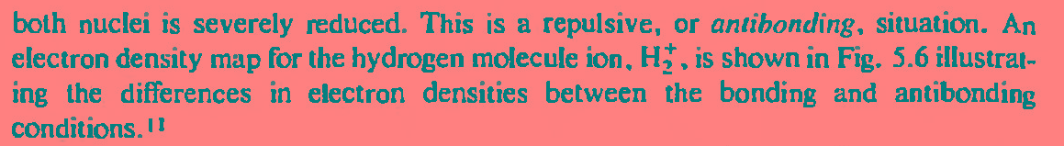

Slide 46
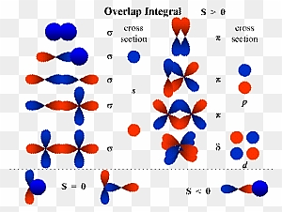

Slide 47
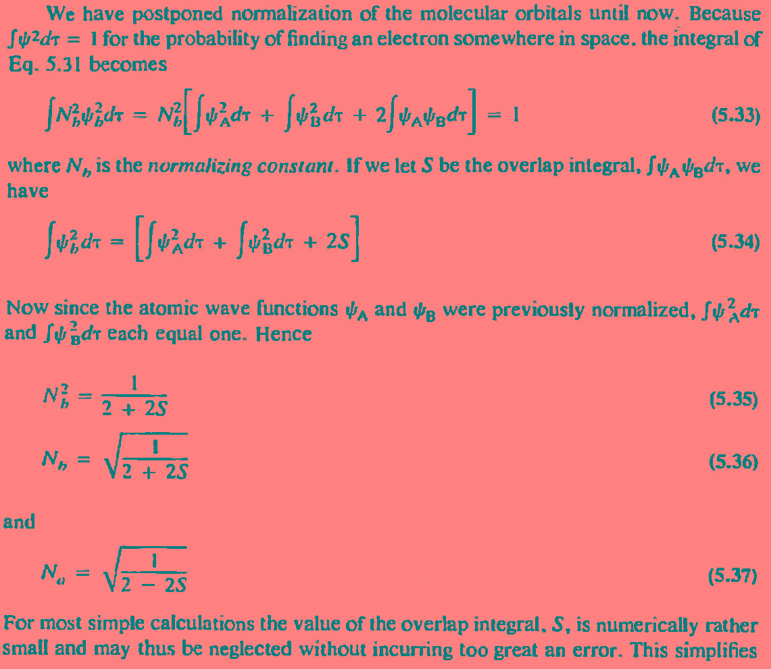

Slide 48
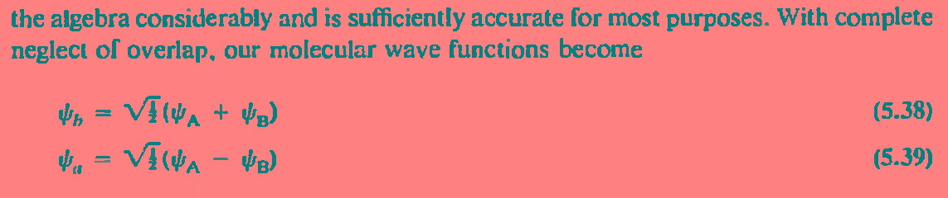
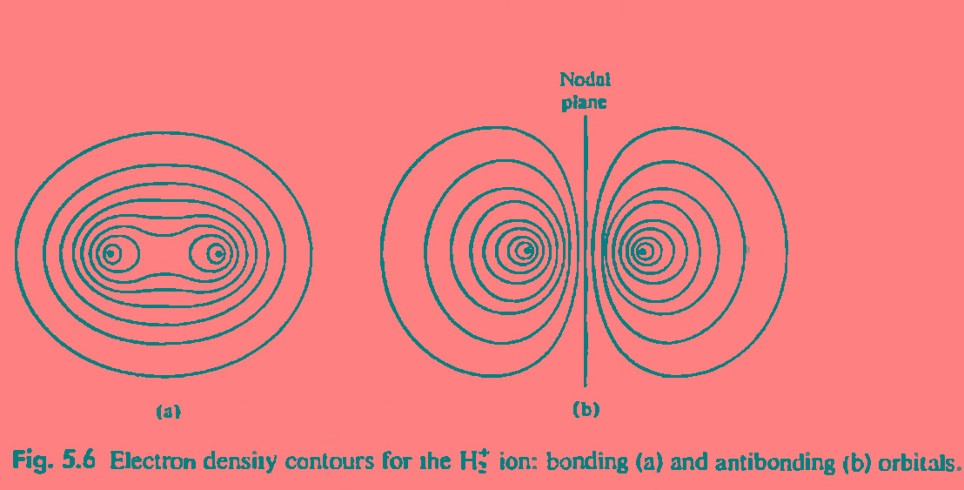

Slide 49


Slide 50


Slide 51


Slide 52


Slide 53


Slide 54


Slide 55


Slide 56


Slide 57

MOED for O₂

Slide 58

Why He₂ molecule does not exit?

Slide 59

Existence of He₂⁺ ionic species

Slide 60

Li₂ molecule exist but Be₂ does not exist-why

Slide 61

What is degeneracy?
Orbitals of similar
energy
For N2 and heavier
elements
For lighter elements
B and C

Slide 62

MOED for Li₂

Slide 63

FMO
LUMO
MOED for B₂
HOMO
Boron is
paramagnetic

Slide 64


MOED for N₂ molecule
Why N₂ is so stable and
activation is challenging

Slide 65


Slide 66


Slide 67



Superoxide
Paramagnetic

Slide 68


Slide 69



HOMODINUCLEAR
HETEROBINUCLEAR

Slide 70


Slide 71

Same MOED for NO
and NO⁺

Slide 72


Slide 73


Slide 74



Slide 75


Slide 76


Slide 77


Slide 78


Slide 79


-

Slide 80



Slide 81


Slide 82


Slide 83


Slide 84


